Slide 1

The Varieties of Drug Experience According to NLP
Tim Meehan
8/23/19

Slide 2

The Process
Scraping
Preprocessing and Topic Modeling
Analysis
Subjective reports of drug experiences from erowid.org
~8,000 reports
15 drugs
Extensive stopword removal, tokenization
TF-IDF → NMF
Extracted 20 topics
Examine strength of topics across drugs
Sentiment analysis: polarity across drugs
What types of experiences are associated with different drugs?

Slide 3
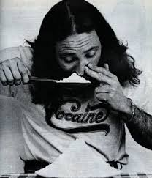
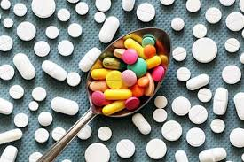
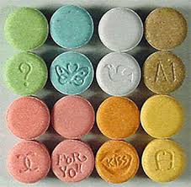

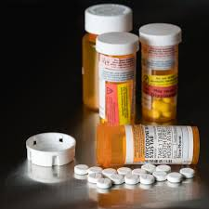
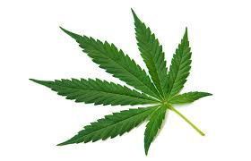
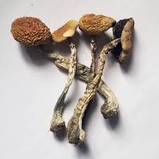

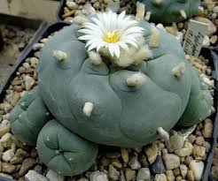
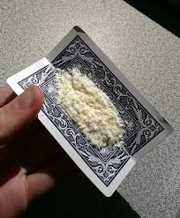
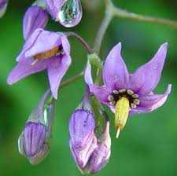
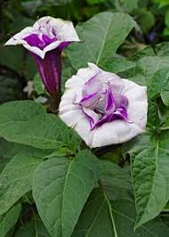
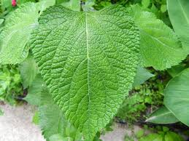
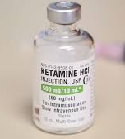
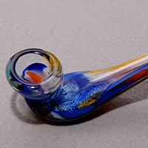
Drugs Overview
Cocaine
Amphetamines
MDMA (Ecstasy)
Nitrous Oxide
Opioids
Less
Mind-Bending
Cannabis
Mushrooms
LSD
Peyote
For Sure
Mind-Bending
DMT
Belladonna
Datura
Salvia
Ketamine
PCP
Mind-
Exploding

Slide 4
Topic Overview: Topics of Topics
Drug Type
Opioids
Salvia/DMT
Nitrous Oxide
Ingestion (e.g. mushrooms)
Setting/Environment
House
Nature
Party/Rave
School
Festival
Nighttime
Driving (yes, driving)
Relationships
Boyfriend
Girlfriend
Family
Sensations
Euphoria/Body
Visuals/Hallucinations
Transcendence
Existential
Spiritual
Weird/Bad Times
Weirdness
Panic

Slide 5
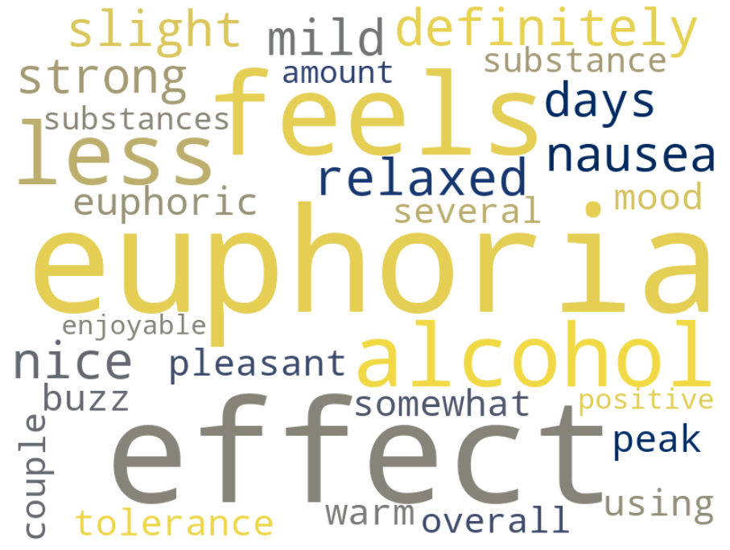
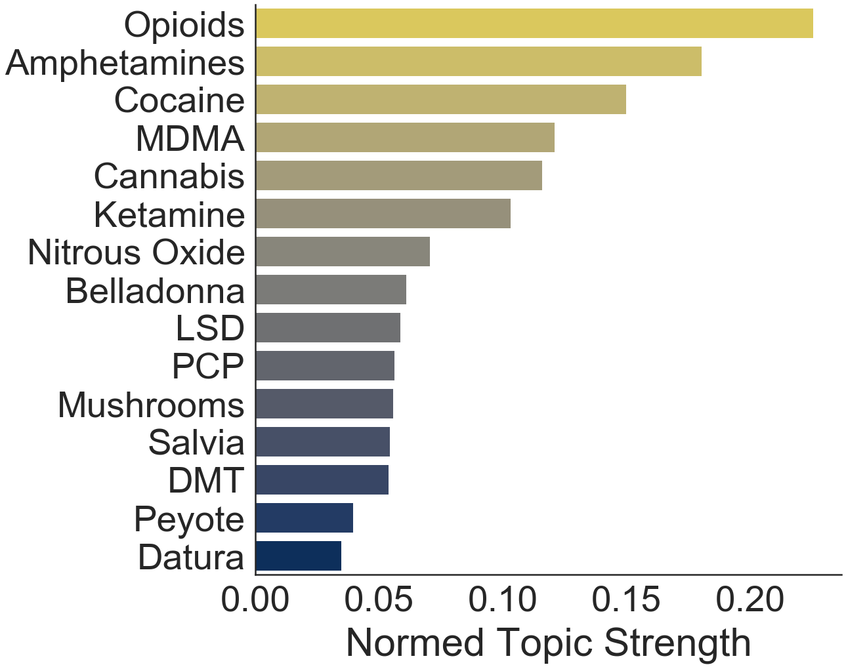
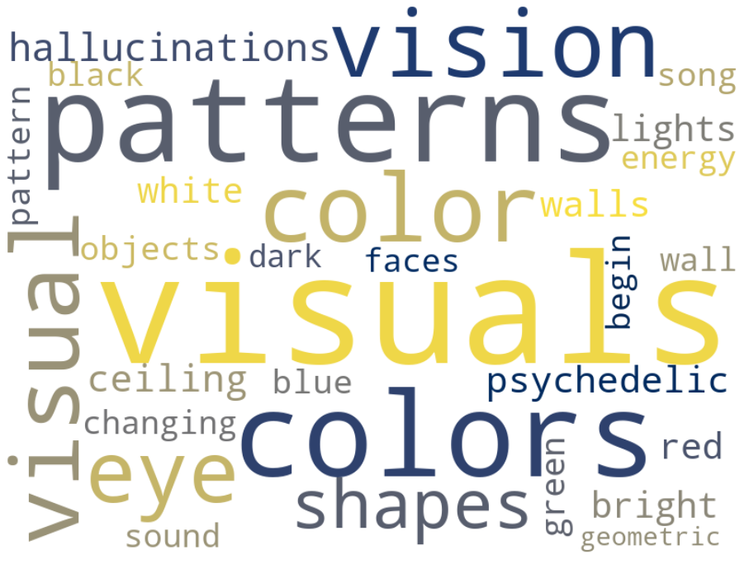
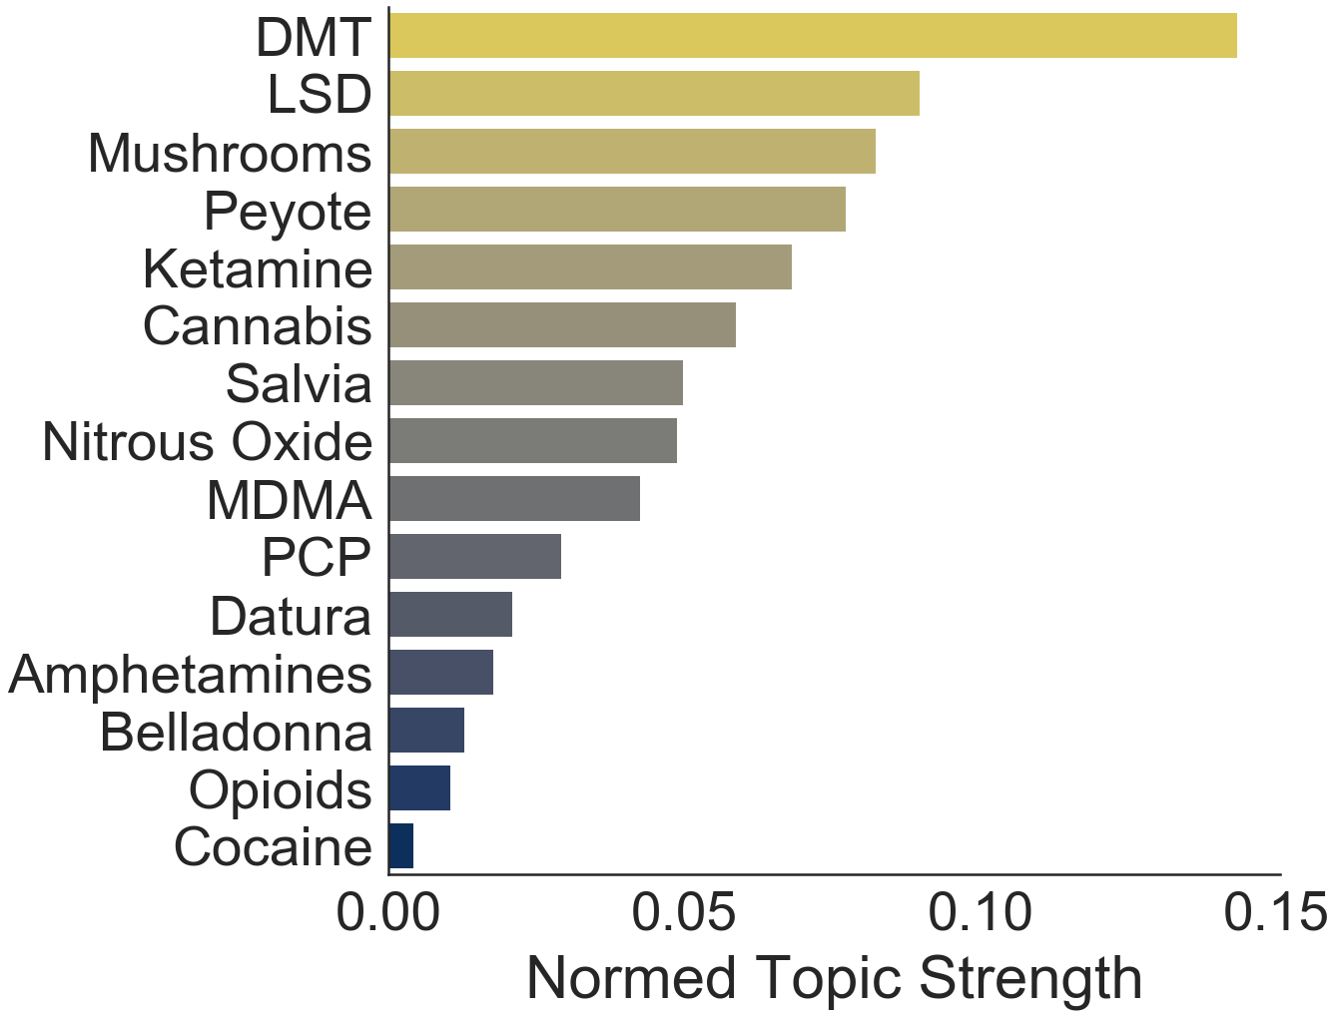
Sensations: Bodily vs Hallucinations
Topic:
Euphoria/
Body
Topic:
Visuals/
Hallucination

Slide 6
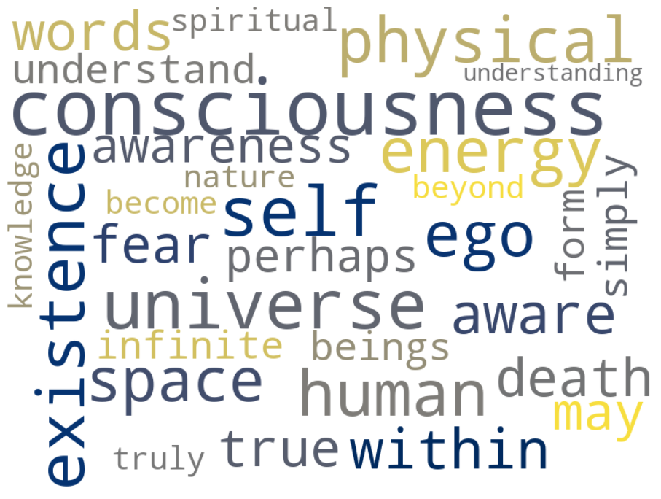
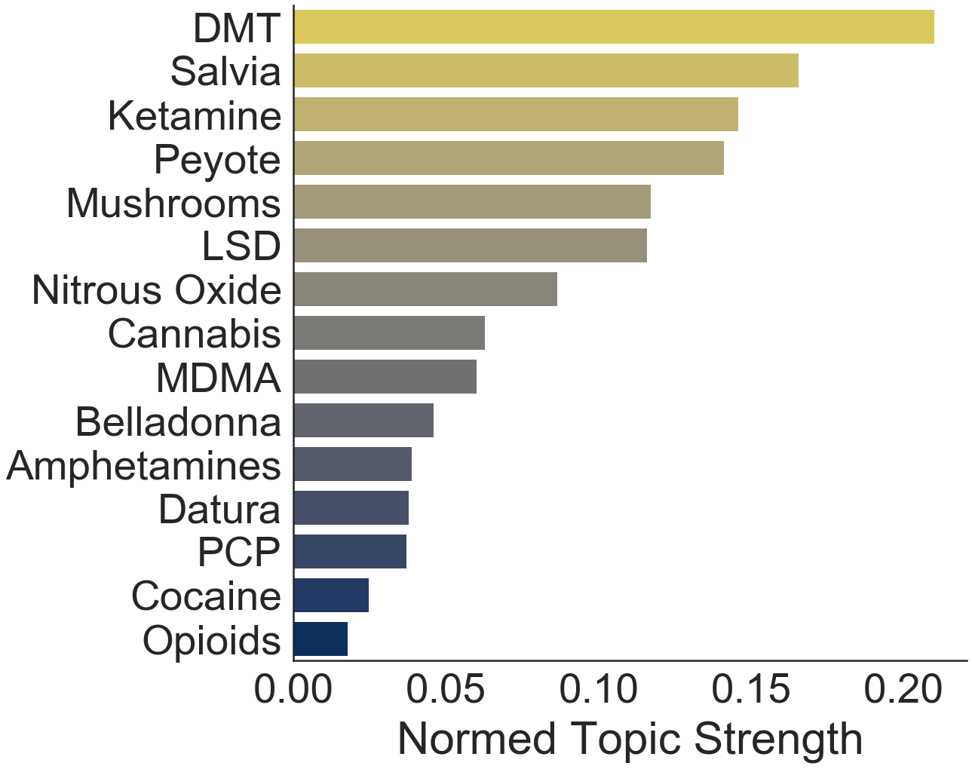
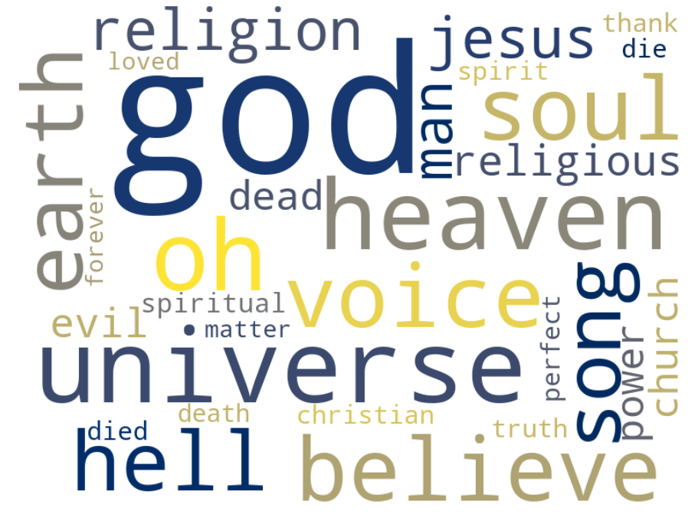
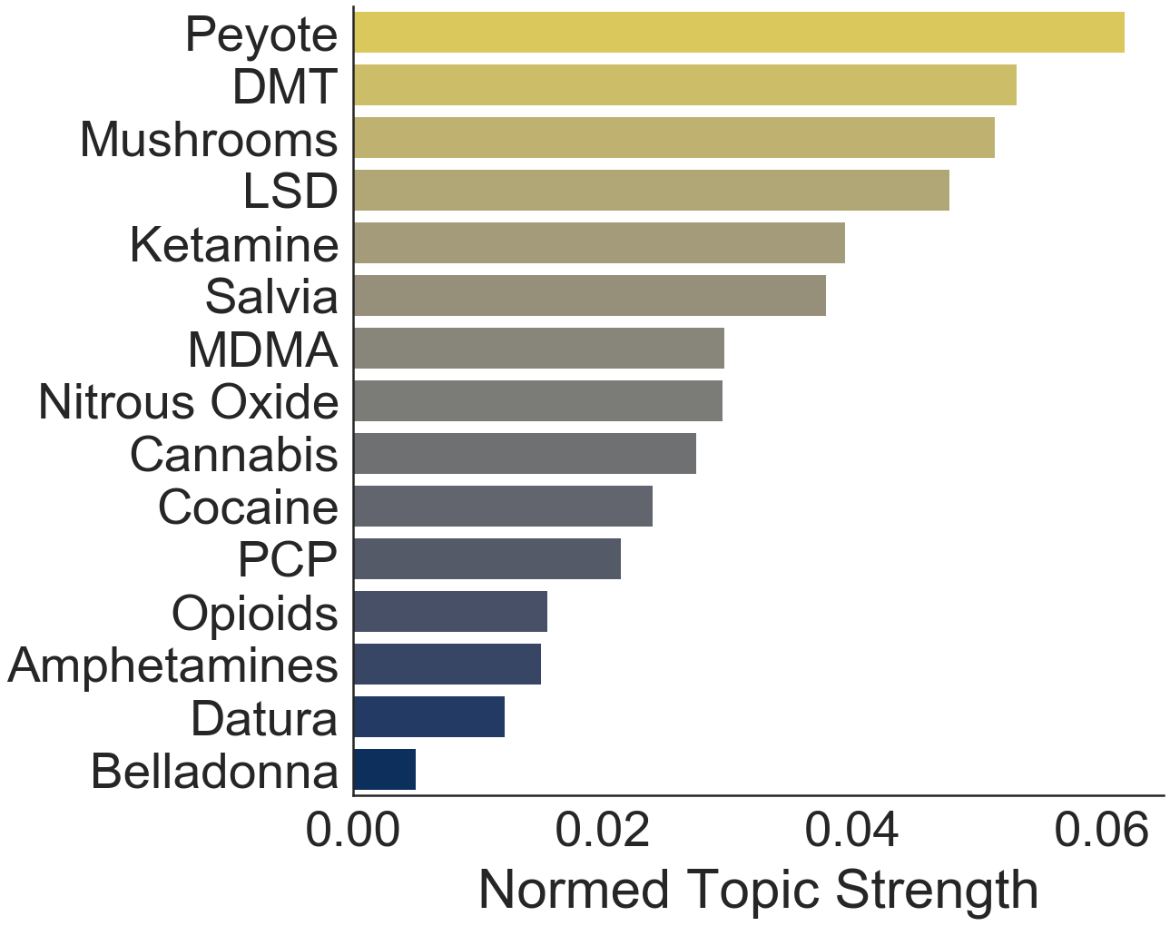
Transcendence: Existential vs Spiritual
Topic:
Existential
Topic:
Spiritual

Slide 7
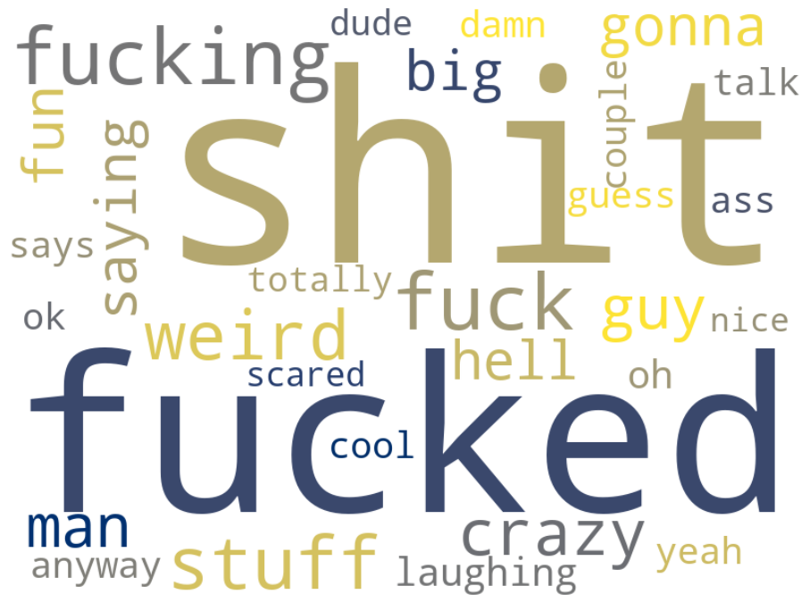
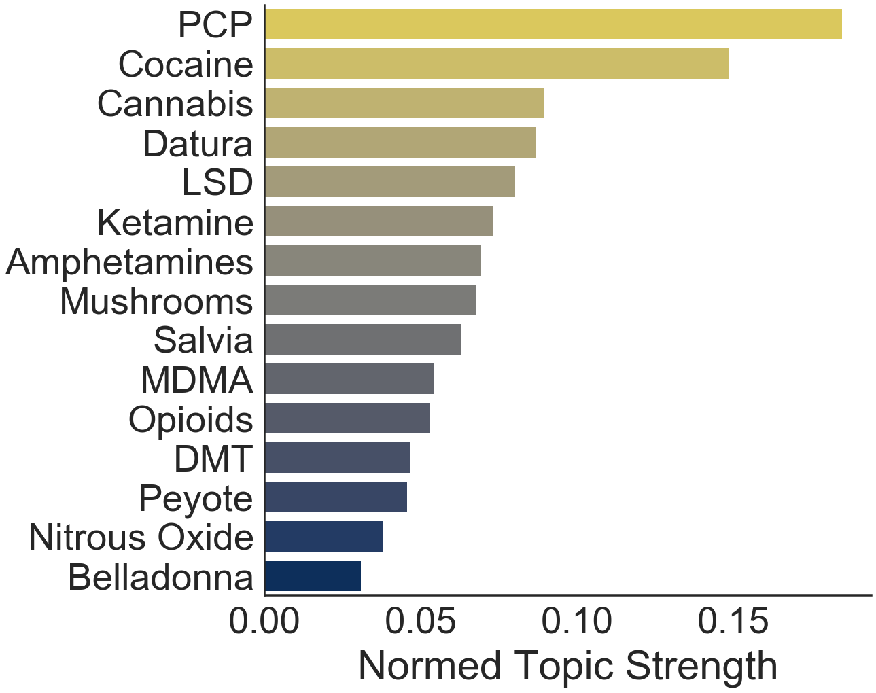
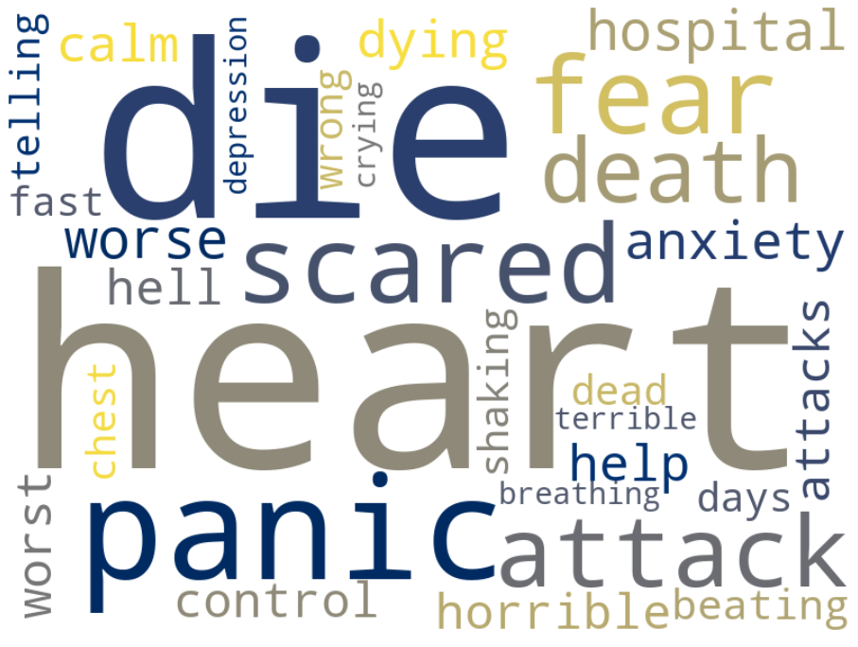
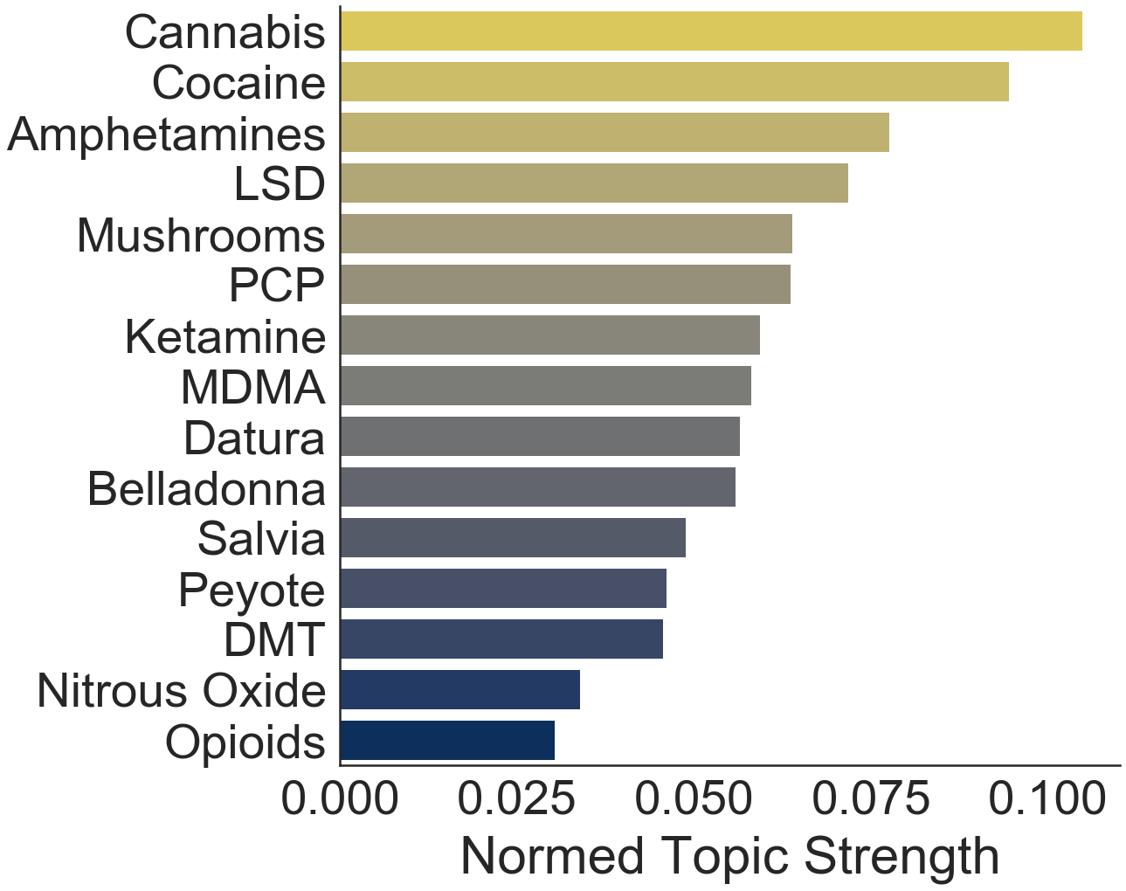
Shit Is Fucked and I’m Dying
Topic:
Weirdness
Topic:
Panic

Slide 8
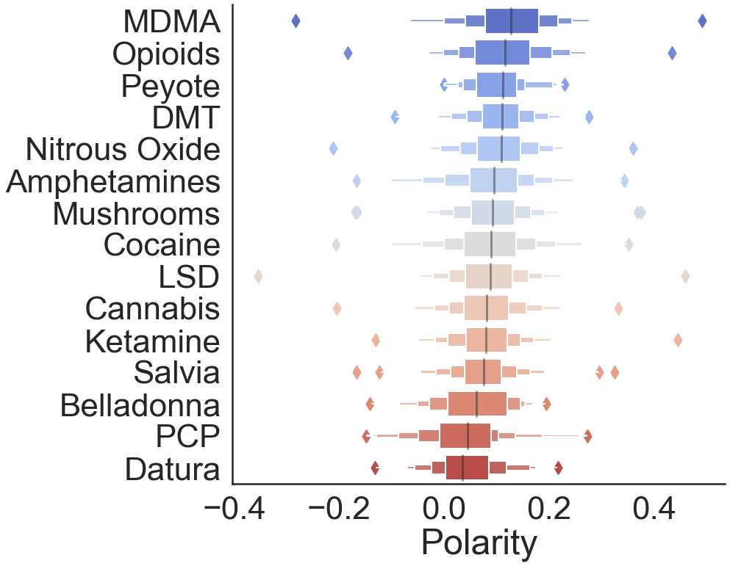
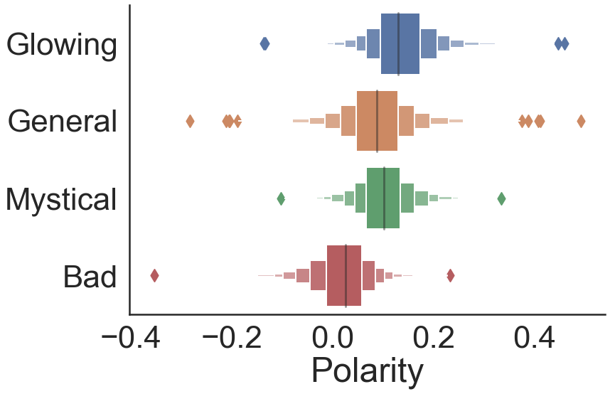
Sentiment Analysis: Experience Polarity
Polarity by Experience Type
(categories from website)
Polarity by Drug

Slide 9
Conclusions
NLP can reveal meaningful themes with regard to drug experiences and particular drugs
Prescriptions:
Try mushrooms, peyote, DMT, LSD if you want to hallucinate and/or meet God
For a positive experience, try ecstasy
Maybe steer clear of the mind-exploders
Obvious disclaimer: do not take my advice

Slide 10

Thank you, and be safe

Slide 11

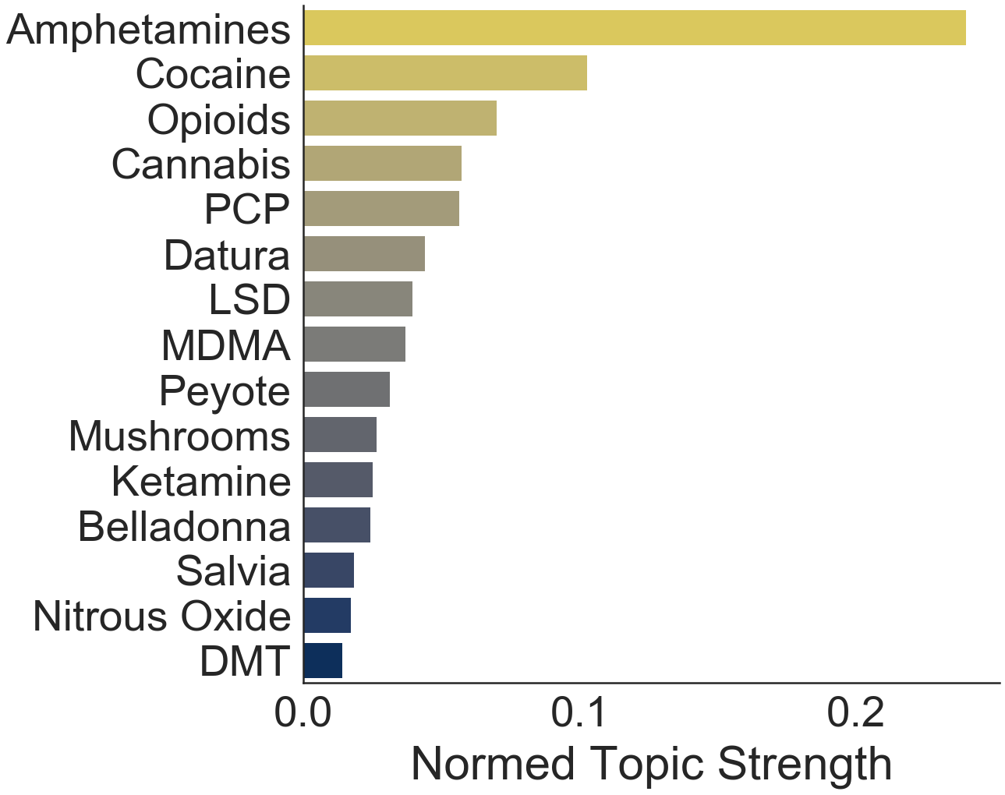
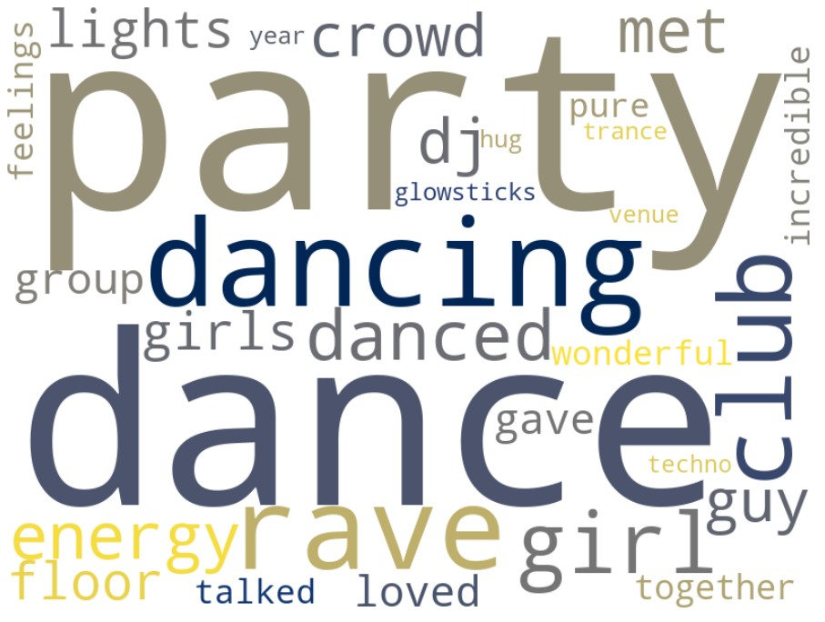
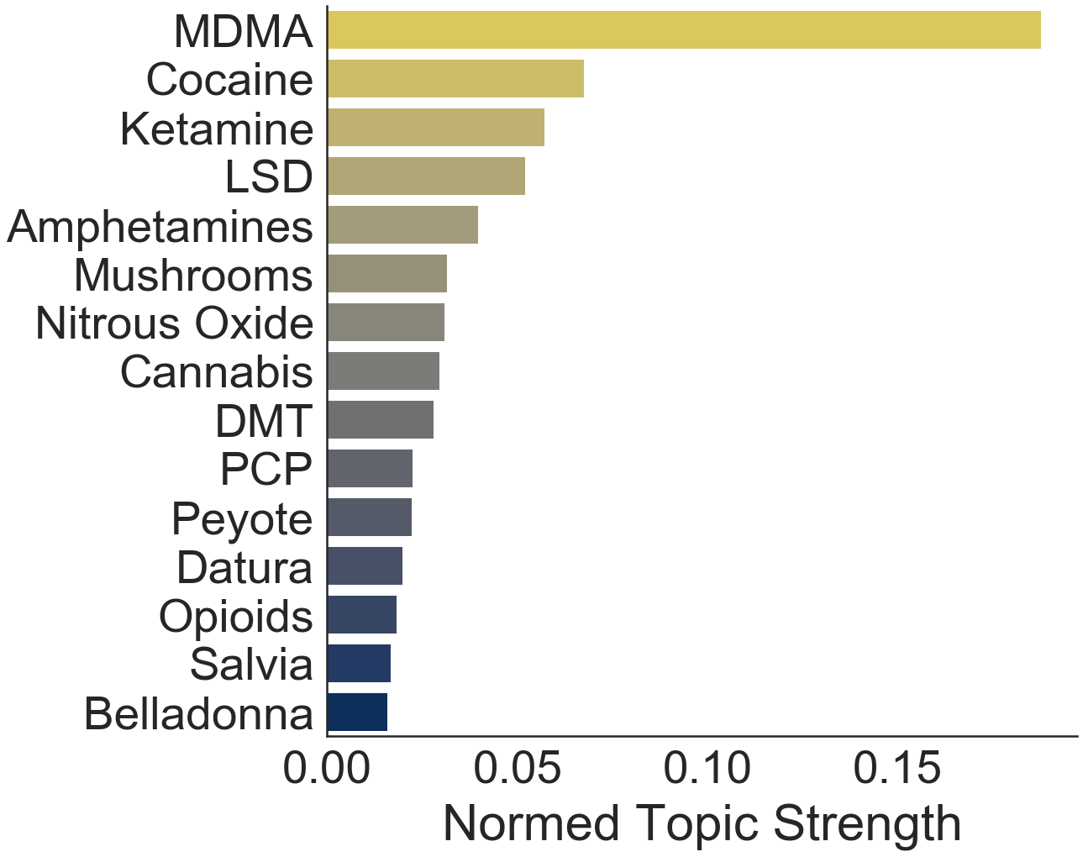
Kids These Days
Topic:
School
Topic:
Party/Rave

Slide 12
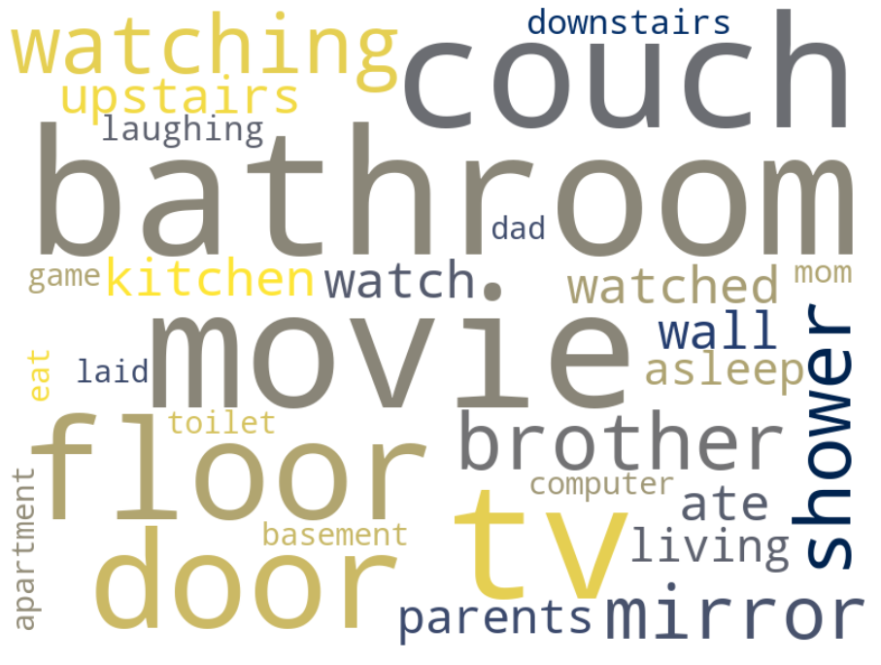
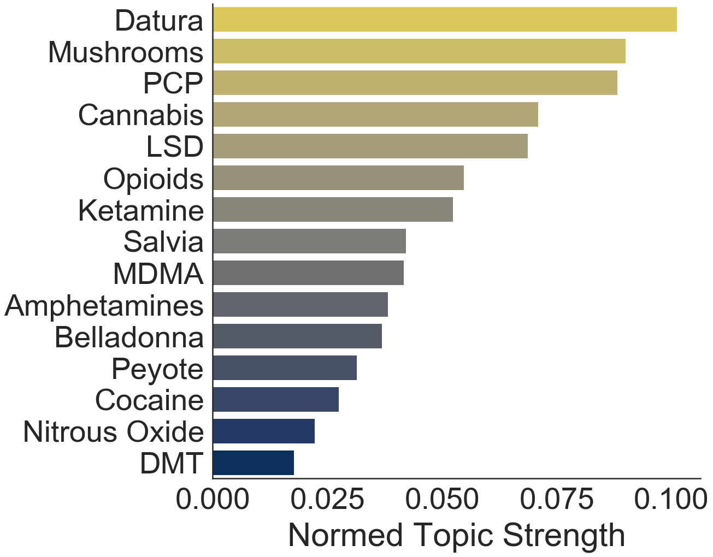
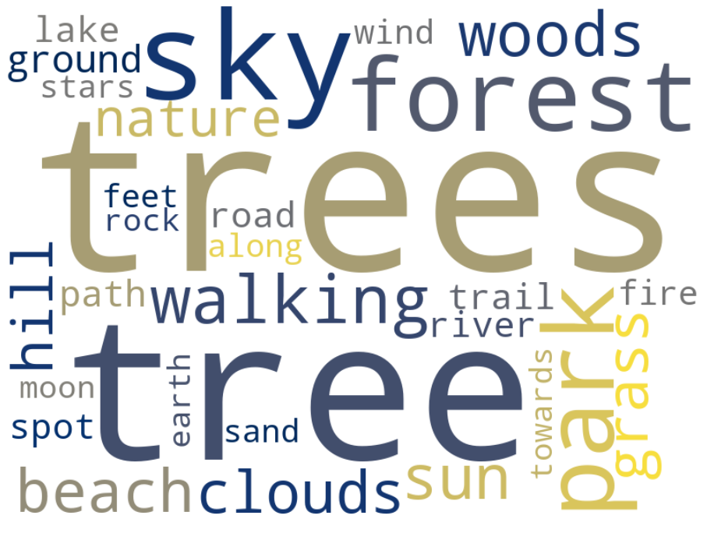
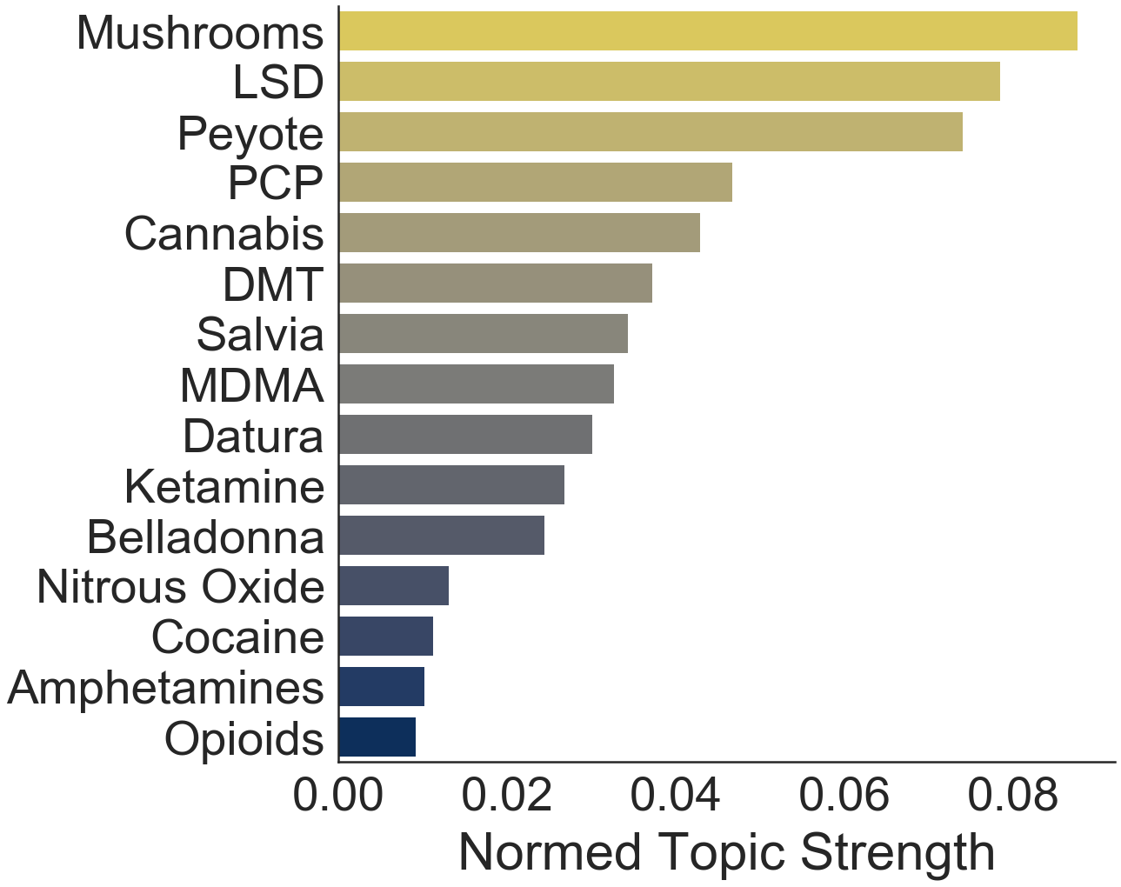
Indoors or Outdoors?
Topic:
House
Topic:
Nature

